Slide 1
Chapter 6
The Cultural Determinants of Democracy and Dictatorship

Slide 2
Introduction: 2 views of culture
Primordialist arguments treat culture as something that is objective and inherited—something that has been fixed since “primordial” times.
Culture precedes politics; only certain cultures have the features necessary for democracy
Constructivist arguments treat culture as something that is constructed or invented rather than inherited.
Democracy requires a certain cultural context to succeed, but any culture could change to create such a context.

Slide 3
Classical Cultural Arguments: Mill and Montesquieu
The notion that political institutions, such as democracy and dictatorship, are more suited to some cultures than others is not new.
Aeschylus, The Persians, 472 BC
Authoritarianism in Asia, democracy in Athens
This argument would be echoed in the “Asian Values” Debate in the 1990s.

Slide 4
Classical Cultural Arguments: Mill and Montesquieu
Montesquieu (1721, 1752)
Each form of government requires definite cultural patterns to be present to endure:
Monarchy is most suited to European states.
Despotism is most suited to the Orient.
Democracy is most suited to the ancient world.
As a result, Montesquieu says that it is only by chance that you can successfully export the institutions of one country to another.

Slide 5
Classical Cultural Arguments: Mill and Montesquieu
John Stuart Mill (1861)
“No one believes that every people is capable of working every sort of institutions.” (Mill 1861)
Even those who wanted "civilized” government could not sustain it without the right “mental” and “moral habits.” They also needed some degree of development.
Legislators should take account of “pre-existing habits and feelings” when making laws and creating institutions.

Slide 6
Classical Cultural Arguments: Mill and Montesquieu
The claims illustrate several potential problems that characterize some cultural arguments to this day.
1. Neither scholar specifically states exactly what it is about culture that matters for democracy.
2. The second problem relates to the purported causal relationship between cultural, economic, and political factors.

Slide 7
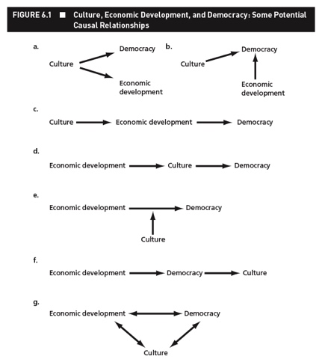

Slide 8
Cultural Modernization Theory
Cultural modernization theory argues:
Unlike stories of economic modernization, socioeconomic development does not directly cause democracy.
Economic development produces certain cultural changes and it is these cultural changes that ultimately produce democratic reform.

Slide 9
Cultural Modernization Theory
"Socioeconomic development brings roughly predictable cultural changes…[and] these changes make democracy increasingly likely to emerge where it does not yet exist…”
- Inghlehart & Welzel (2005, p. 15)

Slide 10
Does Democracy Require a Civic Culture?
Almond and Verba, The Civic Culture, 1965
Three types of political culture
Parochial—suitable for traditional tribal and clan-based governance
Subject—suitable for centralized authoritarian systems
Participant—suitable for democracy
Only “participant” or “civic” culture is compatible with democracy.

Slide 11
Does Democracy Require a Civic Culture?
Almond and Verba, The Civic Culture, 1965
Culture—how individuals think and feel about the political system
In particular, it depends on
Whether individuals believe they can influence political decisions – “political efficacy”
Whether they feel positive toward the political system
Whether they believe citizens are trustworthy
Whether they prefer gradual or revolutionary societal change

Slide 12
Does Democracy Require a Civic Culture?
Almond and Verba, The Civic Culture, 1965
Almond and Verba studied the United States, the United Kingdom, Germany, Italy, and Mexico
They found that the United States and United Kingdom were the most stable democracies and had political cultures that most closely resembled the civic culture.
They concluded that civic culture was necessary for democracy.

Slide 13
Does Democracy Require a Civic Culture?
Inglehart (1990) reached a similar conclusion
Democracy was related to
Levels of life satisfaction
Levels of interpersonal trust
Support for gradual versus revolutionary change

Slide 14
Does Democracy Require a Civic Culture?
Inglehart studied 25 industrialized countries
He found that countries with high levels of life satisfaction and interpersonal trust as well as low support for revolutionary change were more stable democracies.
Thus, he concluded that civic culture was necessary for democracy.

Slide 15
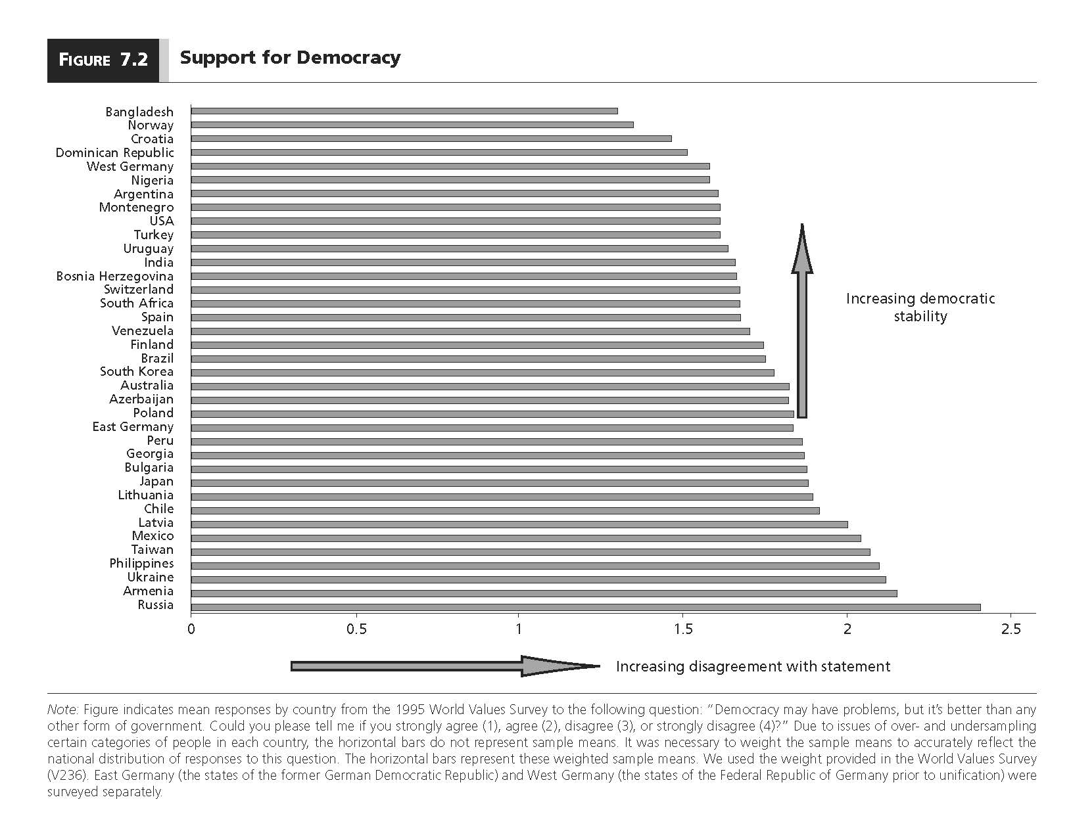
Do you agree democracy is the best form of government?

Slide 16
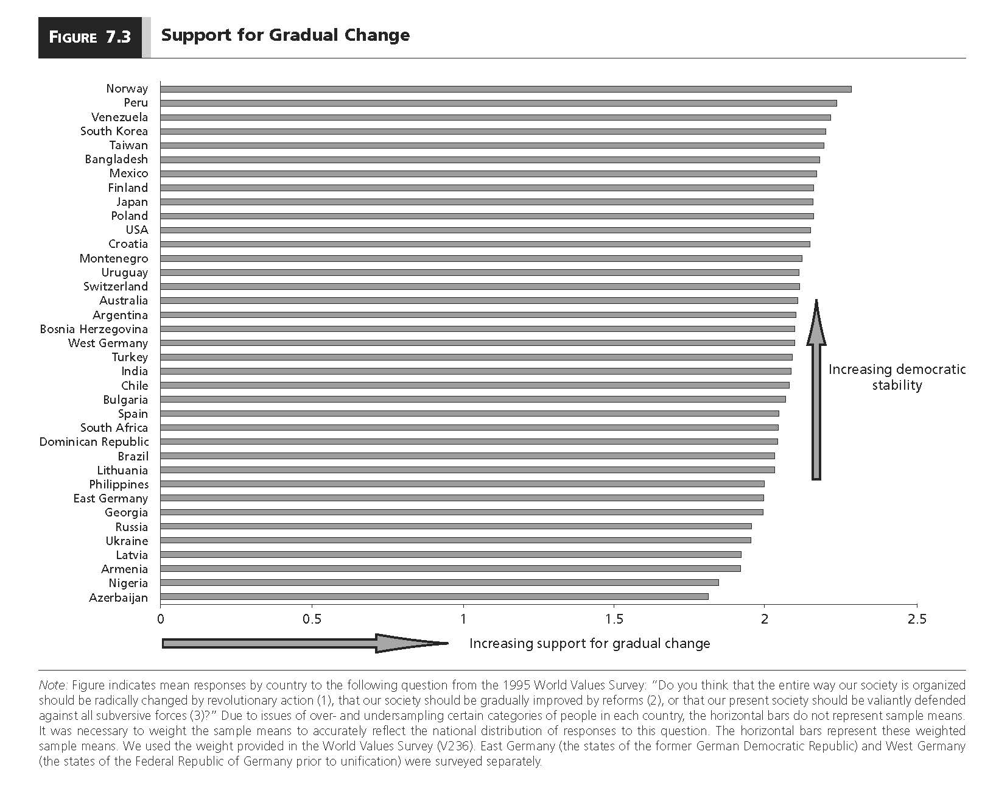
Do you support gradual change?

Slide 17
Does Democracy Require a Civic Culture?
Inglehart and Welzel (2005) claim that there are two major dimensions of cross-cultural variation in the world today.
The first dimension has to do with whether countries exhibit traditional values or secular-rational values.
The second dimension has to do with whether countries exhibit survival values or self-expression values.

Slide 18
Does Democracy Require a Civic Culture?
Inglehart and Welzel (2005) use survey responses to determine the extent to which different societies exhibit traditional versus secular-rational values and the extent to which they exhibit survival versus self-expression values.
They argue that socioeconomic development generally produces a change in cultural values.
The modernization process occurs in phases: industrialization and post-industrialization.

Slide 19
Does Democracy Require a Civic Culture?
traditional values: emphasize religion, traditional family roles and deference to authority.
secular-rational values: place less emphasis on above, and tend to be more accepting of divorce, abortion and euthanasia.
survival values: emphasize physical and economic security. Tend to have an ethnocentric worldview and less trust and tolerance.
self-expression values: emphasize gender and racial equality, environment, tolerance, civic activism and life satisfaction.

Slide 20
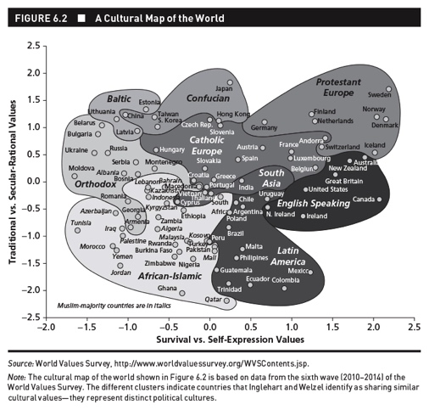
Industrialization
Post Industrialization

Slide 22
Democratic Chicken and Egg Problems
There’s been considerable debate about the exact causal relationship between culture, economic development, and democracy
Values story—cultural values shape and determine political institutions
Economic development → Culture → Democracy
Institutional story—economic development generates democracy and experience with democracy creates cultural change
Economic development → Democracy→ Culture

Slide 23
Surveys and Comparative Research
Surveys and Comparative Research
One of the major impacts of Almond and Verba’s Civic Culture was to encourage the use of surveys to examine the relationship between culture and democracy.
In this field, the most commonly used survey today is the World Values Survey.
Founded by Inglehart
www.worldvaluessurvey.org
Includes “77 countries and societies on all inhabited continents around the globe, ranging from Albania, Australia, and Argentina, to United States, Vietnam, and Zimbabwe.”

Slide 24
Surveys and Comparative Research
Cross-cultural surveys, including the WVS, are increasingly being used in comparative politics.
The World Values Survey asks the following about democracy:
Democracy may have problems, but it’s better than any other form of government. Could you please tell me if you strongly agree, agree, neither agree nor disagree, disagree, or strongly disagree?
- If we ask this in 77 countries, what sort of problems can you imagine?

Slide 25
Surveys and Comparative Research
Surveys are being used to examine many important questions in comparative politics.
Researchers who use surveys often confront two problems:
Addressing sensitive topics (social desirability bias)
Comprehension of survey questions (differential item functioning)

Slide 26
Surveys and Comparative Research
Methods for addressing sensitive topics with surveys
Focus on survey administration
Getting respondents to trust surveyors, often using demographic peers
The use of randomized response techniques
The use of list experiments
Methods for addressing differential item functioning
Anchoring vignettes

Slide 27
Are Some Religions Incompatible With Democracy?
Recent arguments linking culture and democracy have focused on religion.
Huntington argued that Islamic and Confucian cultures are incompatible with democracy.
His book is called Clash of Civilizations
Weber argued that Protestantism encourages democracy but that Catholicism, Orthodox Christianity, Islam, and Confucianism inhibit it.
The Protestant Work Ethic and the Spirit of Capitalism

Slide 28
Are Some Religions Incompatible With Democracy?
Lipset argues that Catholicism’s emphasis on there being only one church/one truth is incompatible with democracy’s need to accept different and competing ideologies as legitimate.
Also the Catholic Church’s historical support of dictatorships like Mussolini’s Italy and Franco’s Spain
Woodberry argues that it was Protestant evangelism’s emphasis on teaching people to read the Bible in their own language, unleashing modernizing forces and creating an educated population.

Slide 29
Are Some Religions Incompatible With Democracy?
Huntington argues that Confucian democracy is a contradiction.
In the Asian Values Debate of the 1990s, some argued that Confucianism’s respect for authority and its emphasis on communalism made it incompatible with democracy.

Slide 30
Are Some Religions Incompatible With Democracy?
Montesquieu argued that Islam had a violent streak that predisposed Muslim societies to authoritarianism.
Huntington argues that one of the reasons democracy is so difficult to establish in Islamic countries is that Muslims are prone to political violence.
“God is Ceasar”
Others say treatment of women under Islam undermines democracy’s inherent egalitarianism.

Slide 31
Are Some Religions Incompatible With Democracy?
Although the argument that some religions are incompatible with democracy have their supporters, there are good reasons to doubt their veracity.
A common thread in these arguments is that there is something inherent in the doctrines of these religions that make them incompatible with democracy.
But all religions have some elements that seem compatible and some that seem incompatible with democracy.
Notes:
The problem is that nearly all religions have doctrinal elements that make them seem both compatible and incompatible with democracy.

Slide 32
Are Some Religions Incompatible With Democracy?
What About Confucianism and Islam?
Confucianism’s meritocratic system and its emphasis on the importance of education and religious tolerance suggest that it can sustain democracy.
Islamic scholars have come to the conclusion that general elections and a parliament properly serve the Koranic concept of shura or consultation.
Constitution of Medina—created by Muhammed himself—was religiously tolerant and pluralistic

Slide 33
Are Some Religions Incompatible With Democracy?
The empirical reality is that all religions have historically been compatible with a broad range of political institutions.
Growing evidence that cultures are invented, constructed, and malleable rather than primordial, inherited, and unchanging.

Slide 34
Are Some Religions Incompatible With Democracy?
Almost all religions contain doctrinal elements that can be viewed as harmful to democracy and others that can be seen as helpful.
It becomes an empirical question as to whether certain religions pose particular difficulties for democracy.
Most of the arguments that particular religions are incompatible with democracy are implicitly based on observations of the world at a particular point in time.
This is not a particularly good way of developing theories.

Slide 35
Experiments and Culture
We now examine some results from experiments that suggest culture might be important for democracy.
The experiments involve individuals playing what are commonly known as Ultimatum Games
Other primates also have played such games

Slide 36
Experiments and Culture
Ultimatum Game
The setup
Players—there is a “proposer” and a “responder.”
The proposer is given a divisible pot of money.
The procedure
Step 1: The proposer offers some share of the money to the responder.
Step 2: The responder knowing the offer and size of the pot has to accept or reject the offer.
The outcome
If the responder accepts, she gets to keep the offer and the proposer keeps the rest.
If the responder rejects, then neither player receives anything.

Slide 37


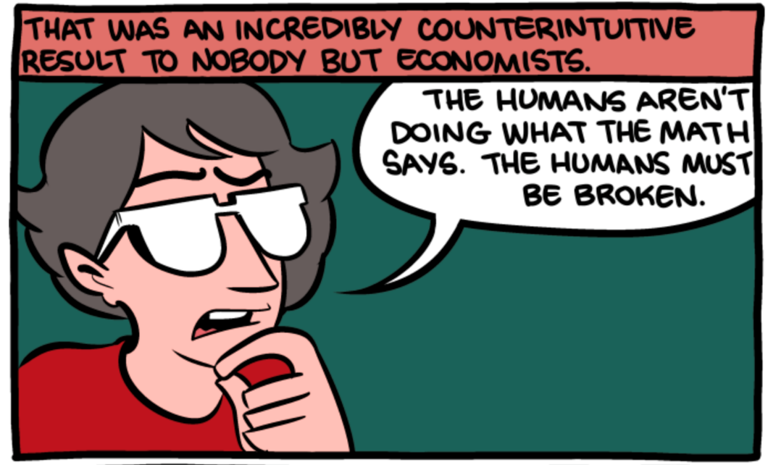
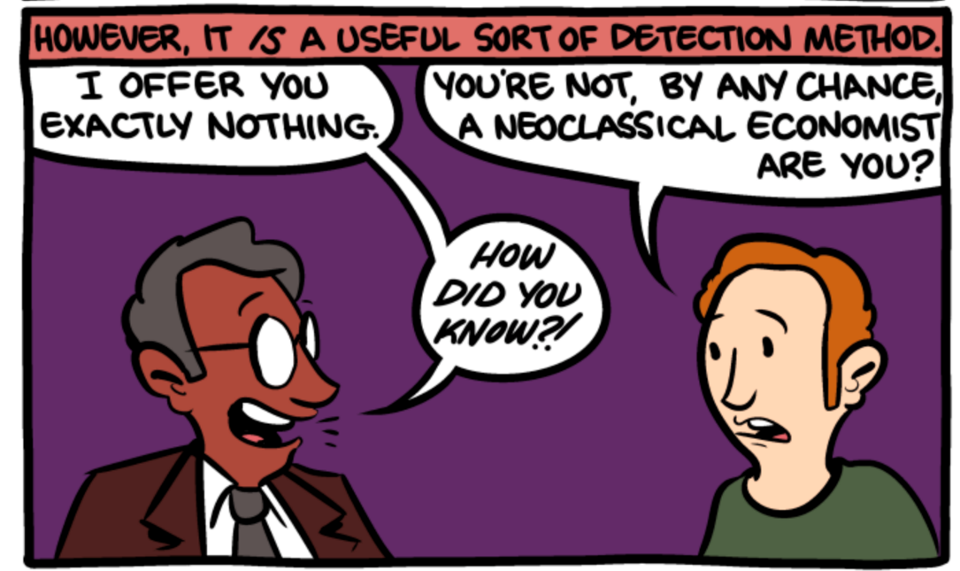

Slide 38
Experiments and Culture
The Dictator Game is exactly the same as the Ultimatum Game except that the responder is not given an opportunity to accept or reject the offer.
The proposer (dictator) merely dictates the division.
This game offers an interesting contrast to the Ultimatum Game because it allows the analyst to see if a proposer makes a positive offer out of a “sense of fairness” or “fear of rejection.”

Slide 39
Experiments and Culture
Both the Ultimatum and Dictator Games have been played in numerous experimental settings in virtually all of the industrialized democracies in the world.
The results from these experiments suggest that the way these games are played varies systematically across cultures.

Slide 40
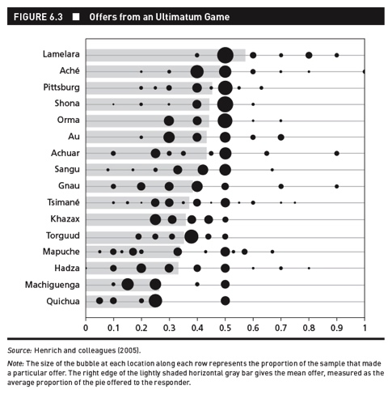

Slide 41

Lamelara hunting whales.

Slide 42
Experiments and Culture
When faced with novel situation, they look for analogs in their daily experience, saying, “what familiar situation is this like?” and then they act in a way appropriate for analogous situation.
Culture is perhaps a shared way of playing games. Life is made up of lots of strategic situations and our culture affects how we play in these games.
Higher degrees of cooperation and market integration were associated with higher offers in the game.
What are the implications of these experiments for the relationship between culture and democracy?

Slide 43
Experiments and Culture
We can think of democracy as a game that individuals must play.
Some countries will find it easier to support democracy than others because the individuals in those countries will have analogous games in their everyday lives that make it beneficial and easier for them to play the democracy game.
In other words, culture—a shared way of playing games—may well affect the emergence and survival of democracy.
We need more research on this question—we just don’t know at the moment.

Slide 44

Civic Culture and Social Capital
Social capital: the collective value of social networks and shared norms that promote reciprocity, trust, and social cooperation
Social capital has been made famous by Robert Putnam in two books: Making Democracy Work and Bowling Alone.

